Slide 1



KERBEROS
Presented by :
Rharif Anass
Supervised :
Mr.Maleh Yassine

Slide 2


Summary
01
Introduction
02
How Kerberos Authentication Works
03
Advantages of Kerberos
04
DEMO
05
Conclusion

Slide 3


Introduction
On most computer systems, your password is used to prove your identities but anyone khnowing you password will effectively be you, which is not good.
Therefore it is necessary to prevent anyone from eavesdropping on your password on a unsecure network. It is also necessary to provide a means of authenticating users to use any service anytime.
These can be done with kerberos, which is designed for two purposes : Security and authentication.

Slide 4


How Kerberos Authentication Works

Slide 5
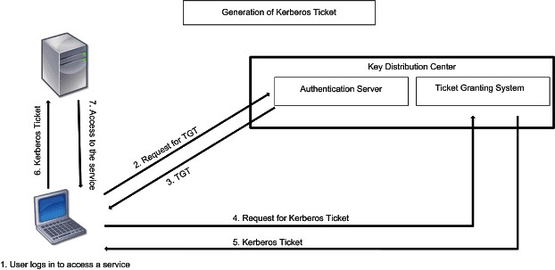
Step 1 : the client sends a request for TGT to Authentication Server . His request is partially encrypted with a secret key: his password. keep in mind, he never sends his password over the unsecure network , he just uses it as an encryption key.
When the AS gets the client's request for TGT , it will retrieve his password in the Database based on userID , and use his password as a key to decrypt his request. keep in mind, his password is a shared secret key between AS and the client. THIS IS HOW THE USER IS VERIFIED.
After verifying the client, the AS sends back the TGT encrypted with another secret key.

Slide 6
Step 2 : After the client gets the TGT , he sends it to Ticket Granting Server (TGS) along with his request . When the TGS gest the TGT, it decrypts the ticket with the secret key shared with AS, then the TGS issues the client a token/ticket which is encrypted with another secret key.
this third secret key is shared betwn TGS and the file server.

Slide 7
Step 3 : When the file server gets the ticket sent by the client, it decrypts it with the secret key shared with TGS.
The file server allows the client to use its resources for a certain period of time according to the ticket.

Slide 8
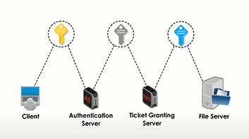
as we can see , all communications between the different parties involved a SECRET KEY .
for example:
- the client and authentication server share a scret key which is his password.
- AS and TGS share a secret key and TGS and the file server also share the same
secret key.

Slide 9

Advantages of kerberos
1. It is so safe that passwords
will never be sent to the network;
only keys are allowed to send.
2. Always mutual authentication
happens so that client and server
get connected at the same step
and communicate with the right
counterpart.
3. The best advantage is
authentication is always reusable,
and it will never expire.
4. It completely depends on the
internet standard.

Slide 10
DEMO :
Connect the client machine to the server through ssh
with the Kerberos authentication.

Slide 11


To conclude, Kerberos is a network authentication protocol that allows proper authentication between a server and a client
It’s free and open source.
It is an essential tool to provide optimum security while communicating between a server and a client.

